Slide 1

Introduction to Stochastic Processes:
Definitions, Simulations, and Interesting Applications
By
Dr. Olga Korosteleva, CSULB
SOCAL R USER GROUP
FEBRUARY 11, 2023

Slide 2

About Me
BS in Mathematics, Wayne State University, Detroit, MI, 1996
MS in Statistics, Purdue University, West Lafayette, IN, 1998
Ph.D. in Statistics, Purdue University, West Lafayette, IN, 2002
Professor of Statistics, CSU, Long Beach, 2002-present
2

Slide 3

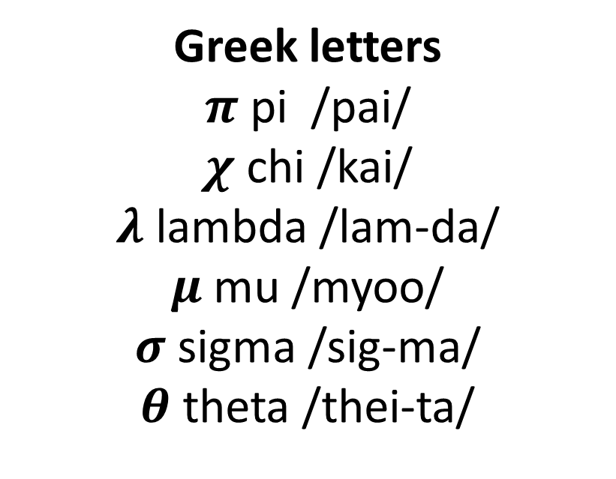
Outline
Markov Chain
Random Walk
Poisson Process
Birth-and-Death Process
Branching Process
Brownian Motion
Greek letters
$π$ pi /pai/
$χ$ chi /kai/
$λ$ lambda /lam-da/
$μ$ mu /myoo/
$σ$ sigma /sig-ma/
$θ$ theta /thei-ta/
3

Slide 4

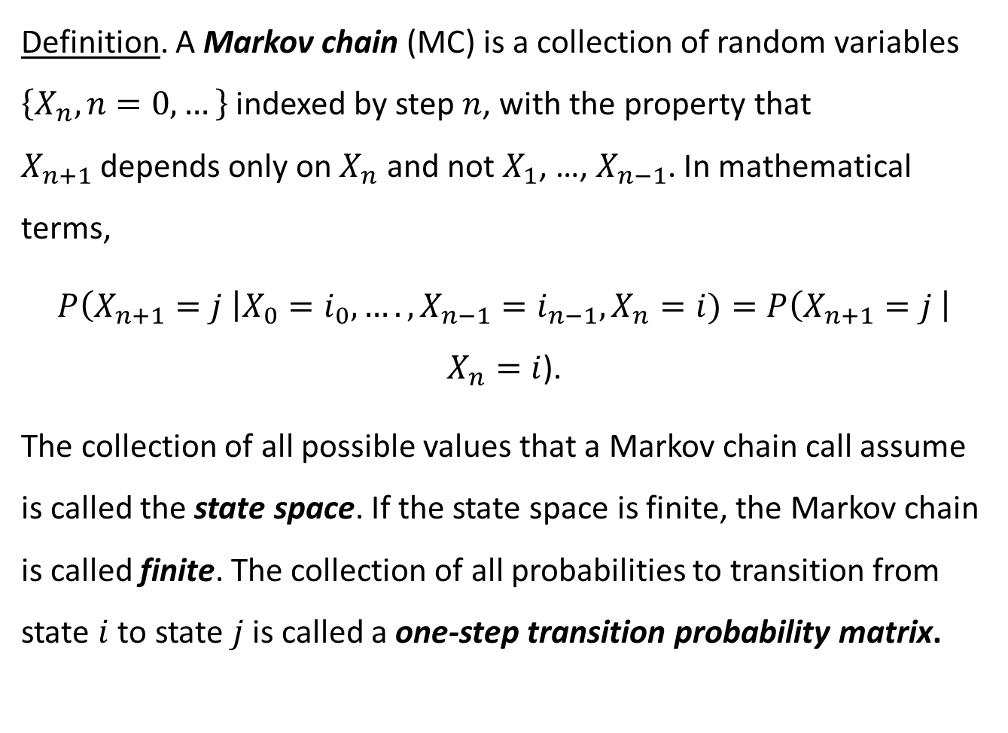
MARKOV CHAIN
Definition. A Markov chain (MC) is a collection of random variables $\left\{X_{n}, n=0, …\right\}$ indexed by step $n$, with the property that $X_{n+1}$depends only on $X_{n}$ and not $X_{1}$, …, $X_{n−1}$. In mathematical terms,
$P\left(X_{n+1}=j \right|X_{0}=i_{0}, …., X_{n−1}=i_{n−1}, X_{n}=i)=P\left(X_{n+1}=j \right|$ $X_{n}=i$).
The collection of all possible values that a Markov chain call assume is called the state space. If the state space is finite, the Markov chain is called finite. The collection of all probabilities to transition from state $i$ to state $j$ is called a one-step transition probability matrix.
4

Slide 5
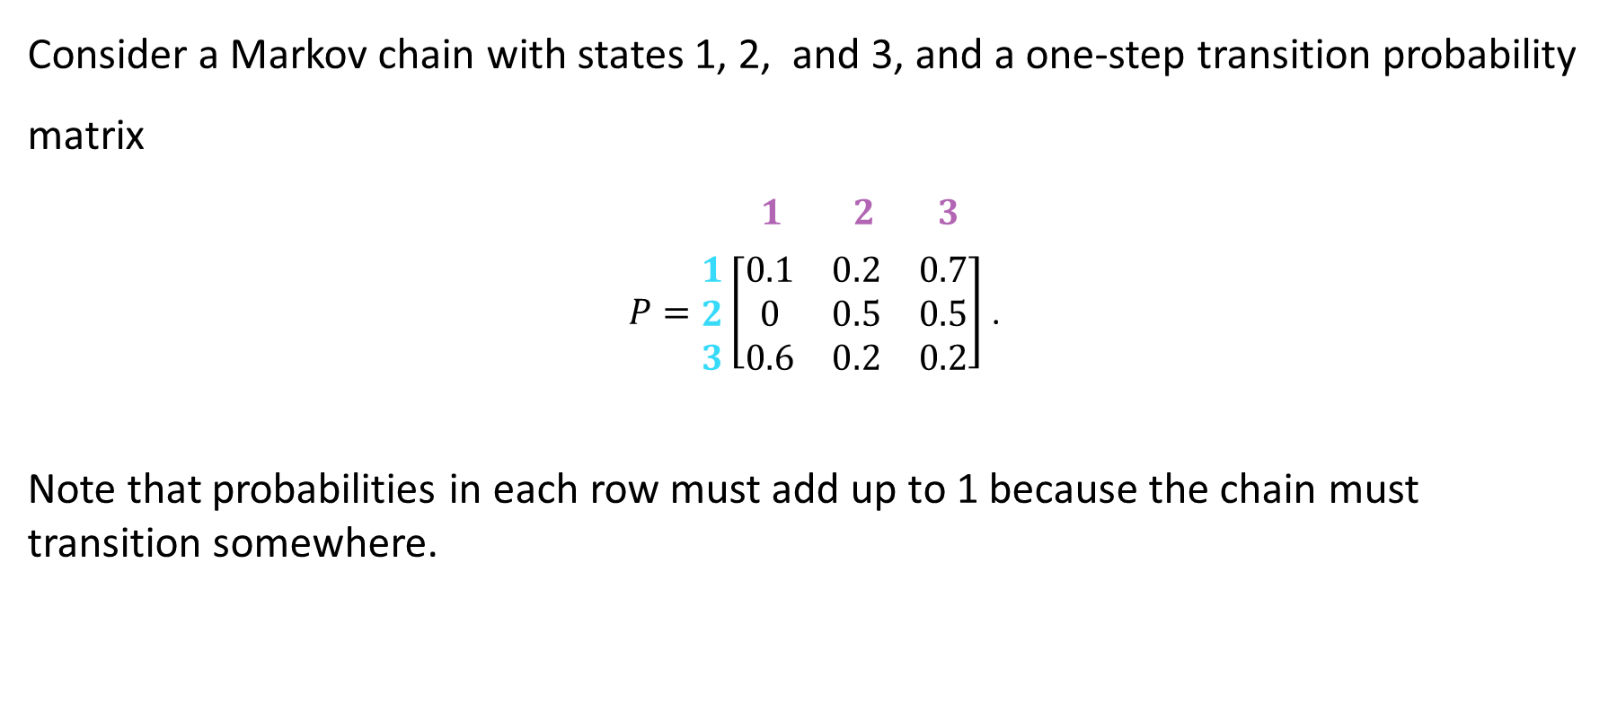
Example of Markov Chain
Consider a Markov chain with states 1, 2, and 3, and a one-step transition probability matrix
$\begin{matrix} 1 & 2 & 3\end{matrix}$
$P=\begin{matrix}1 \\ 2 \\ 3\end{matrix}\left[\begin{matrix}0.1 & 0.2 & 0.7 \\ 0 & 0.5 & 0.5 \\ 0.6 & 0.2 & 0.2\end{matrix}\right]$ .
Note that probabilities in each row must add up to 1 because the chain must transition somewhere.
5

Slide 6
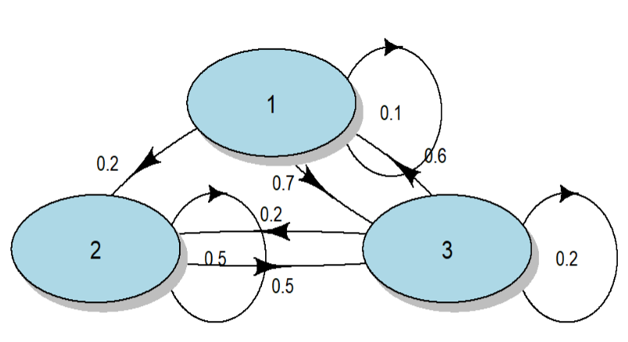
Example of Markov Chain (Cont.)
R CODE
6

Slide 7
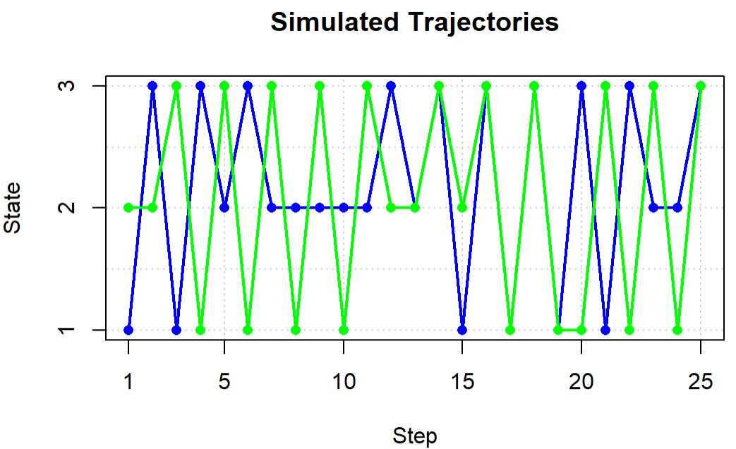
Example of Markov Chain (Cont.)
R CODE
7

Slide 8
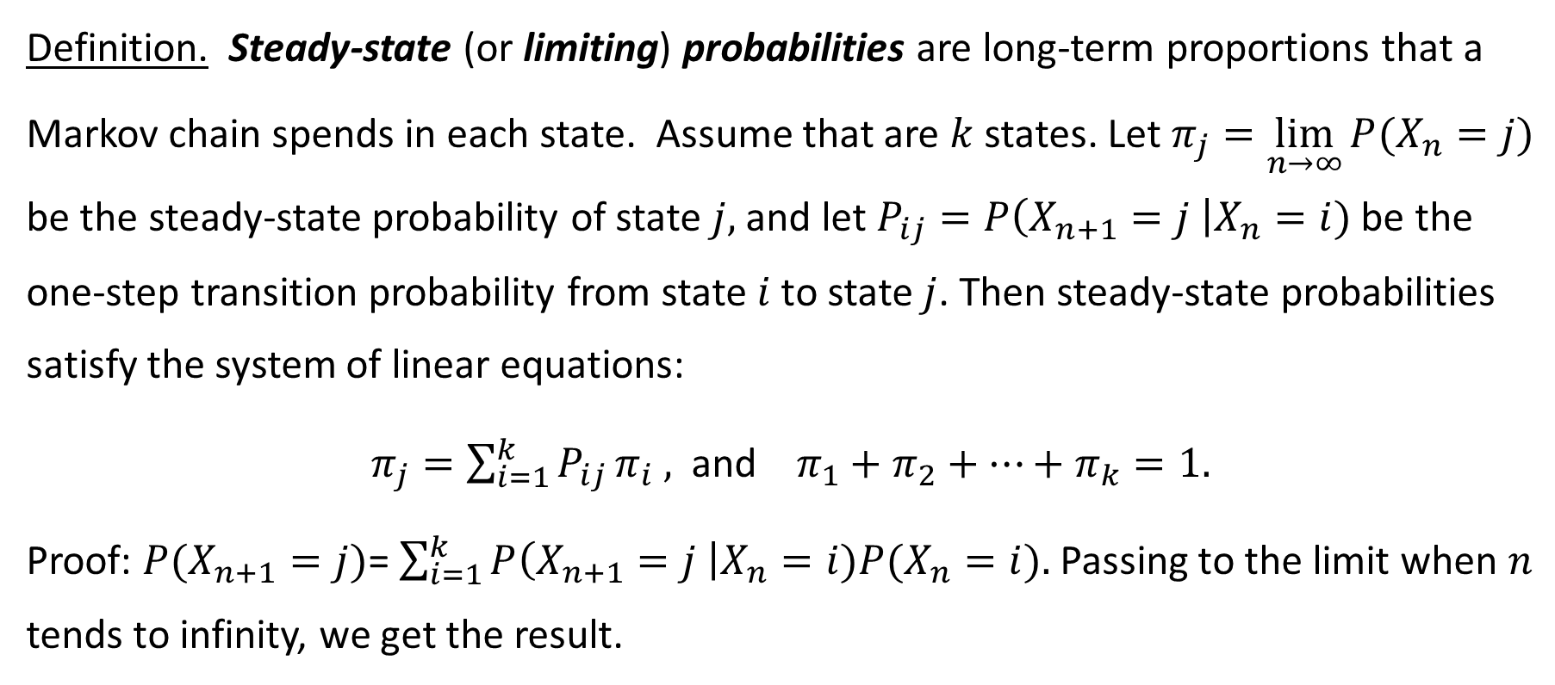
Example of Markov Chain (Cont.)
Definition. Steady-state (or limiting) probabilities are long-term proportions that a Markov chain spends in each state. Assume that are $k$ states. Let $π_{j}=\lim_{n→∞}{P(X_{n}=j)}$ be the steady-state probability of state $j,$ and let $P_{ij}=P\left(X_{n+1}=j \right|X_{n}=i)$ be the one-step transition probability from state $i$ to state $j$. Then steady-state probabilities satisfy the system of linear equations:
$π_{j}=\sum_{i=1}^{k}{P_{ij }π_{i} ,}$ and $π_{1}+π_{2}+…+π_{k}=1.$
Proof: $P(X_{n+1}=j)$= $\sum_{i=1}^{k}{P\left(X_{n+1}=j \right|X_{n}=i)P(X_{n}=i).}$ Passing to the limit when $n$ tends to infinity, we get the result.
8

Slide 9
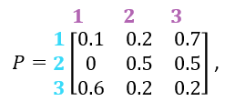
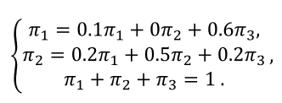
Example of Markov Chain (Cont.)
In our example, the one-step transition probability matrix is
therefore, the steady-state probabilities satisfy the system:
round(steadyStates(mc), digits=4)
1 2 3
0.2857 0.2857 0.4286 The chain will spend 28.57% of the time in state 1, 28.57%
in state 2, and 42.86% in state 3.
9

Slide 10
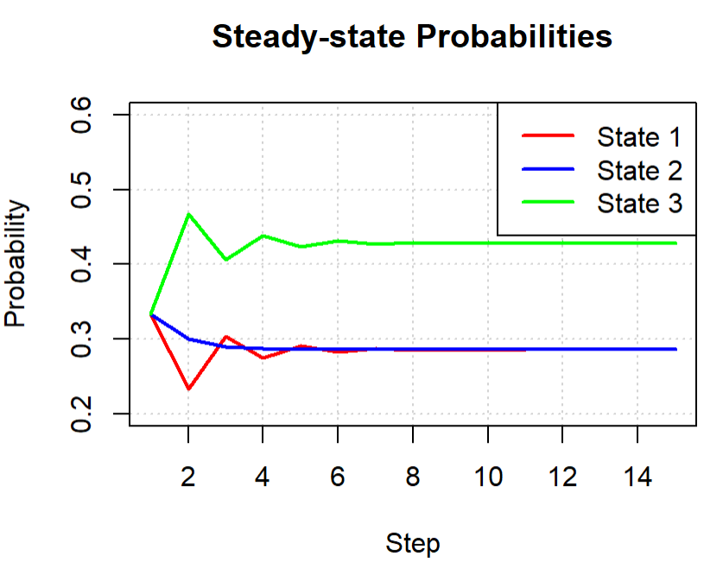
Example of Markov Chain (Cont.)
R CODE
10

Slide 11
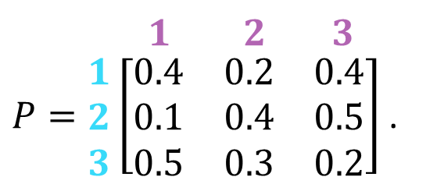
Markov Chain Exercise
Consider a Markov chain with one-step transition probability matrix
Construct a well-labeled diagram for this Markov chain.
Simulate two trajectories starting at a randomly chosen state.
Compute theoretical values for the steady-state probabilities. Interpret.
Depict convergence to the steady-state probabilities. How many steps are required for the chain to settle down?
$\begin{matrix} 1 & 2 & 3\end{matrix}$
$P=\begin{matrix}1 \\ 2 \\ 3\end{matrix}\left[\begin{matrix}0.4 & 0.2 & 0.4 \\ 0.1 & 0.4 & 0.5 \\ 0.5 & 0.3 & 0.2\end{matrix}\right]$ .
11

Slide 12
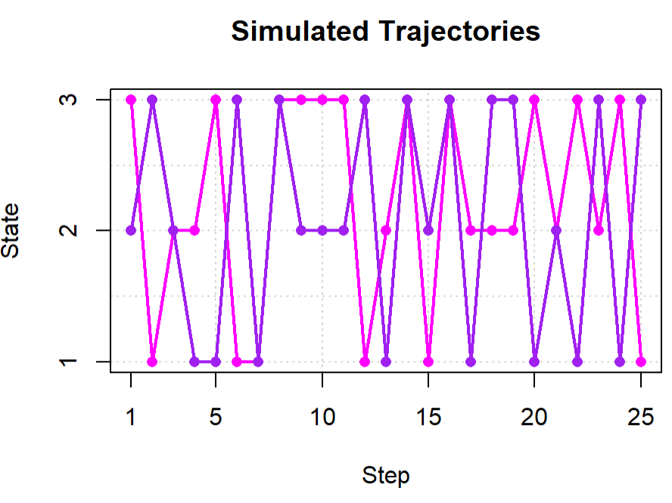
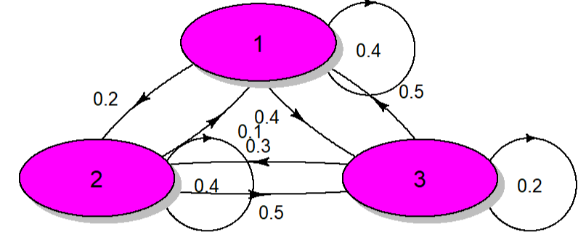
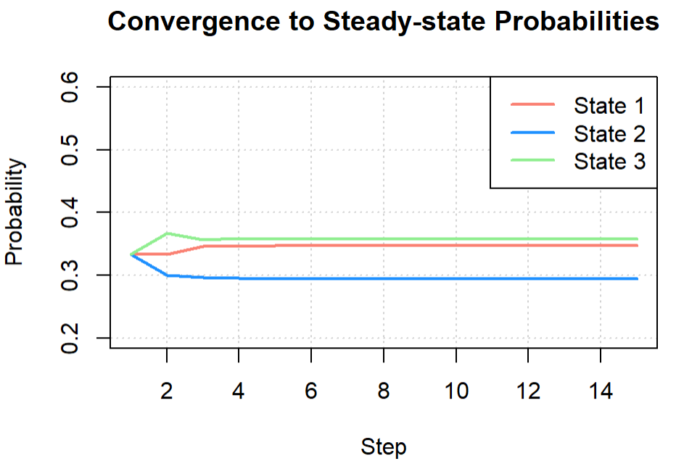
Markov Chain Exercise Solution
> round(steadyStates(mc), digits=4)
1 2 3
0.3474 0.2947 0.3579
34.7% in state 1, 29.5% in state 2, 35.8% in state 3
R CODE
12

Slide 13
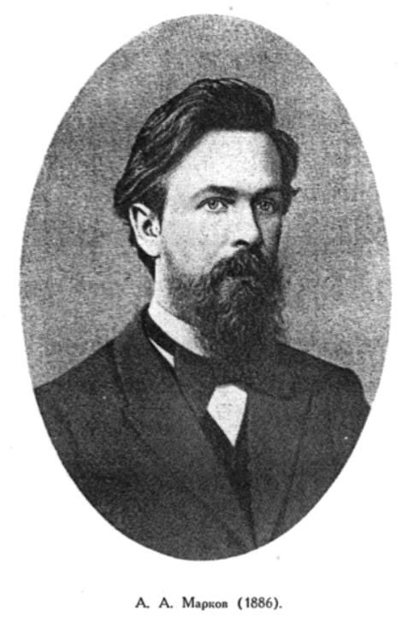
Application of Markov Chain (1)
Markov, A. A. (1913). An example of statistical investigation of the text “Eugene Onegin” concerning the connection of samples in chains. (In Russian.) Bulletin of the Imperial Academy of Sciences of St. Petersburg, 7(3): 153-162.
13

Slide 14
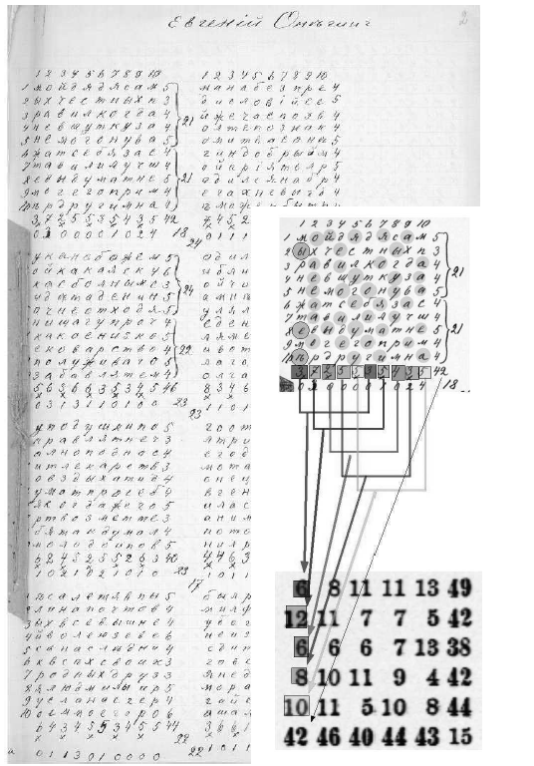
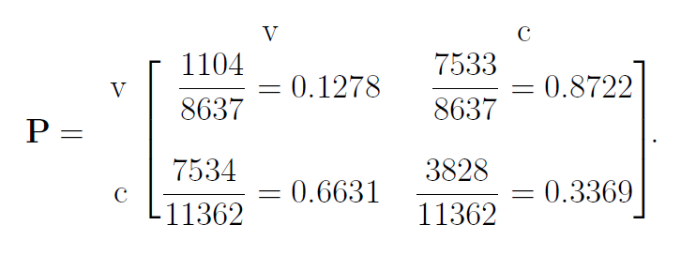
Application of Markov Chain (1) (Cont.)
A.A. Markov took the first 20,000 letters of
“Eugene Onegin” by A.S. Pushkin (just a string of consonants and vowels of Cyrillic alphabet) and computed a one-step transition probability matrix
14

Slide 15




Application of Markov Chain (1) (Cont.)
R CODE
[v] [c]
[v] 0.1370 0.8630
[c] 0.6681 0.3319
[v] [c]
[v] 0.1464 0.8536
[c] 0.5206 0.4794
[v] [c]
[v] 0.1544 0.8456
[c] 0.7027 0.2973
[v] [c]
[v] 0.2284 0.7716 [c] 0.6069 0.3931

Slide 16



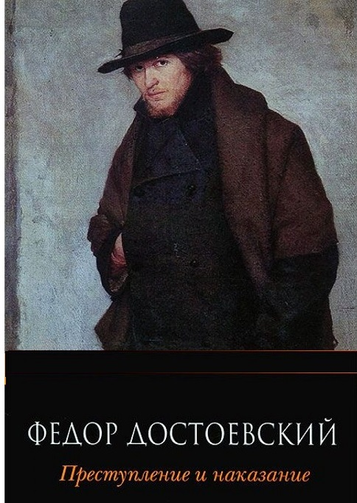
Exercise: Match book with matrix
[v] [c]
[v] 0.1640 0.8360
[c] 0.6996 0.3004
[v] [c]
[v] 0.2392 0.7608
[c] 0.6097 0.3903
[v] [c]
[v] 0.1422 0.8578 [c] 0.5132 0.4868
[v] [c]
[v] 0.1384 0.8616 [c] 0.6866 0.3134

Slide 17


Application of Markov Chain (2)
Staying on the topic of literature, recall that in the famous 1980 movie “Shining”, the main character Jack Torrance (played by Jack Nicholson) repeatedly typed on a typewriter the sentence All work and no play makes Jack a dull boy. This “composition” is a deterministic and is NOT a Markov chain.
17

Slide 18
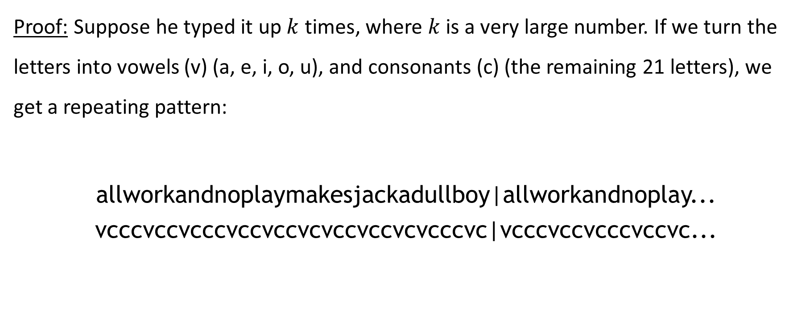
Application of Markov Chain (2) (Cont.)
Proof: Suppose he typed it up $k$ times, where $k$ is a very large number. If we turn the letters into vowels (v) (a, e, i, o, u), and consonants (c) (the remaining 21 letters), we get a repeating pattern:
allworkandnoplaymakesjackadullboy|allworkandnoplay...
vcccvccvcccvccvccvcvccvccvcvcccvc|vcccvccvcccvccvc...
18

Slide 19
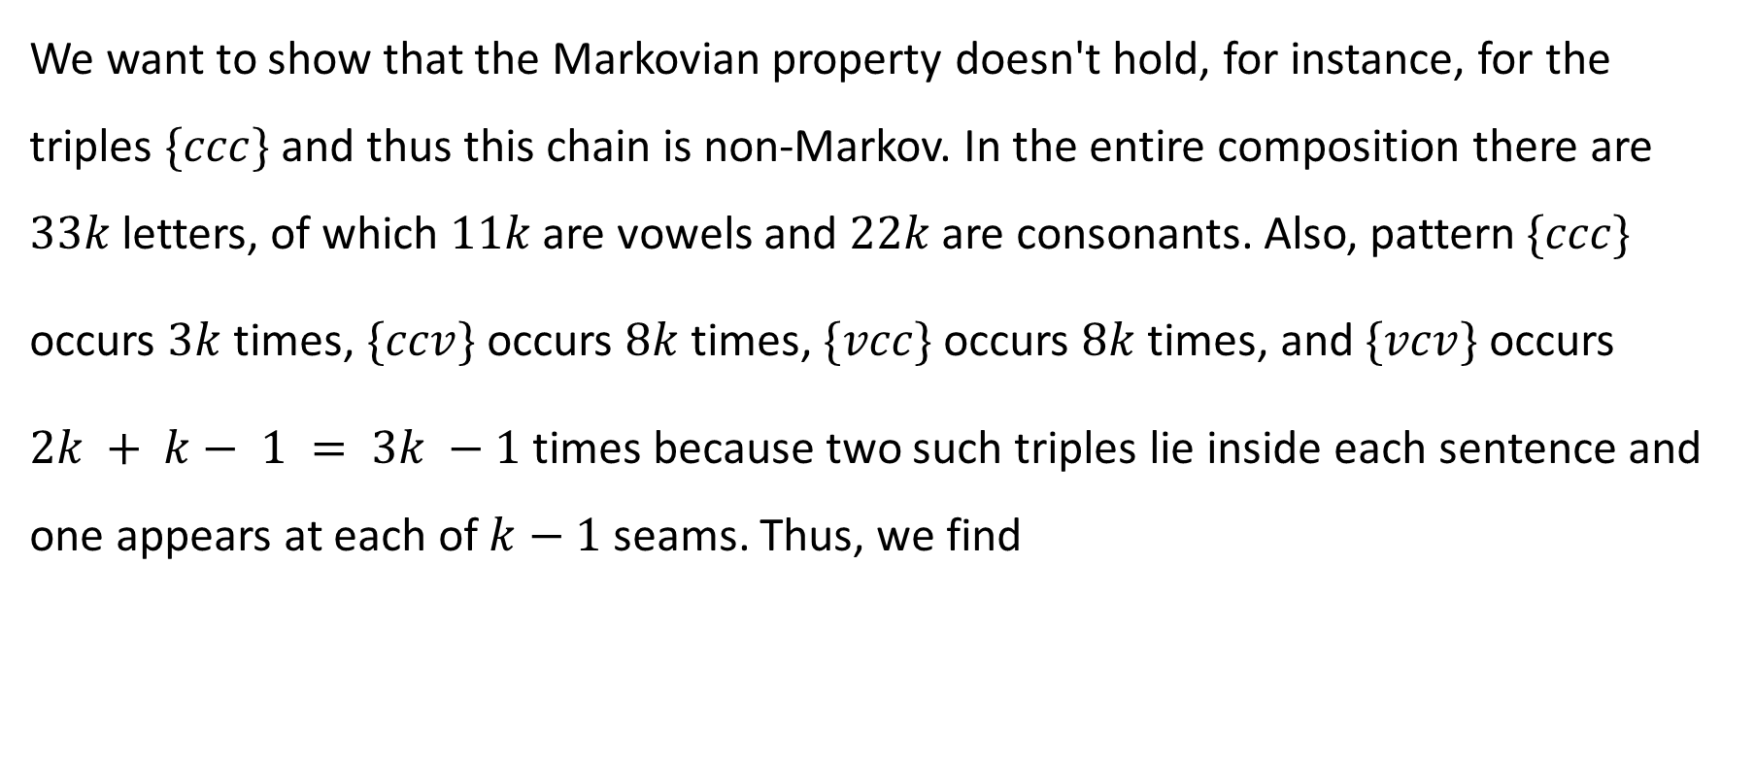
Application of Markov Chain (2) (Cont.)
We want to show that the Markovian property doesn't hold, for instance, for the triples $\{ccc\}$and thus this chain is non-Markov. In the entire composition there are $33k$ letters, of which $11k$ are vowels and $22k$ are consonants. Also, pattern$\{ccc\}$
occurs $3k$ times, $\{ccv\}$occurs $8k$ times, $\{vcc\}$occurs $8k$ times, and $\{vcv\}$occurs
$2k + k− 1 = 3k −1$ times because two such triples lie inside each sentence and one appears at each of $k−1$ seams. Thus, we find
19

Slide 20
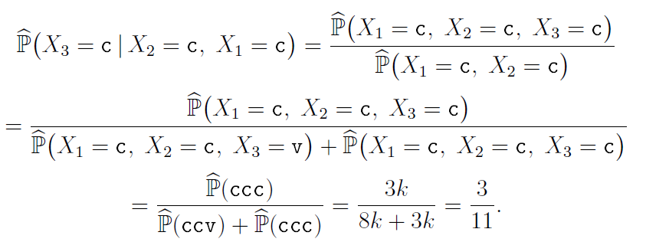
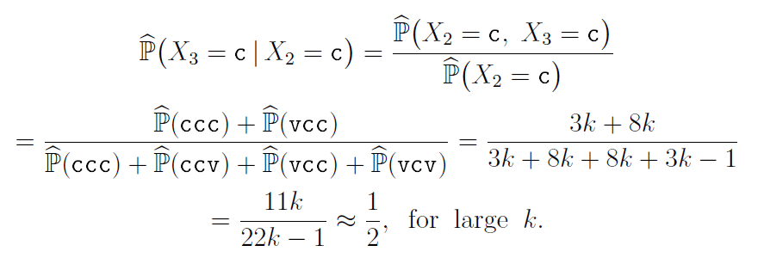
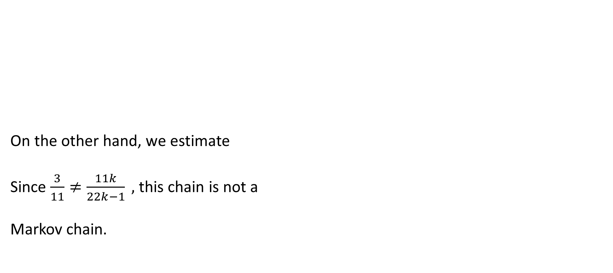
Application of Markov Chain (2) (Cont.)
On the other hand, we estimate
Since $\frac{3}{11}≠\frac{11k}{22k−1} ,$ this chain is not a
Markov chain.
20

Slide 21

Application of Markov Chain (3)
According to the Mendelian model of gene inheritance in humans,
named after Gregor Johann Mendel (1822-1884), a specific genetic
trait is determined by a pair of genes, that can be of three types:
AA, Aa, or aa. During reproduction, an offspring inherits one gene
of the pair from each parent, and genes are selected at random,
independently of each other.
21

Slide 22
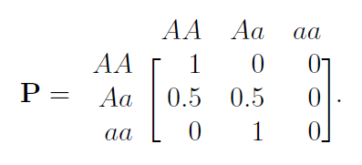
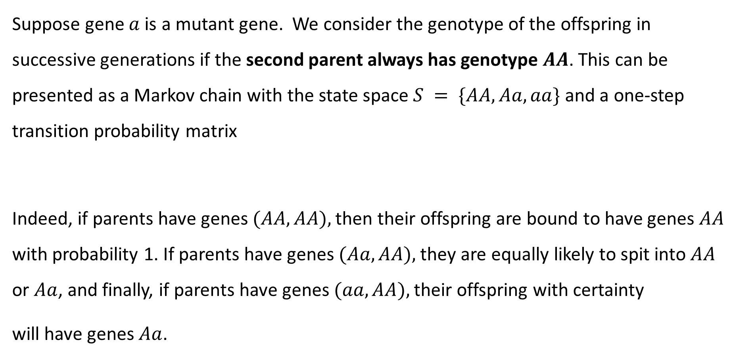
Application of Markov Chain (3) (Cont.)
Suppose gene $a$is a mutant gene. We consider the genotype of the offspring in successive generations if the second parent always has genotype $AA$. This can be presented as a Markov chain with the state space $S = \{AA, Aa, aa\}$and a one-step transition probability matrix
Indeed, if parents have genes $(AA, AA),$then their offspring are bound to have genes $AA$ with probability 1. If parents have genes $(Aa, AA),$they are equally likely to spit into $AA$ or $Aa$, and finally, if parents have genes $(aa, AA),$their offspring with certainty
will have genes $Aa$.
22

Slide 23
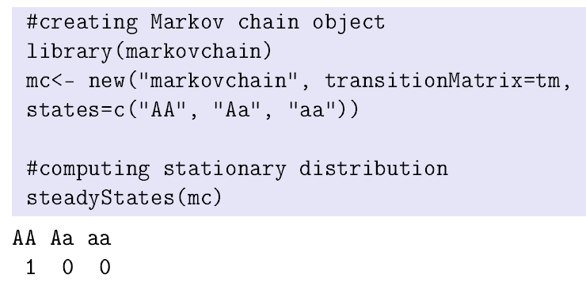
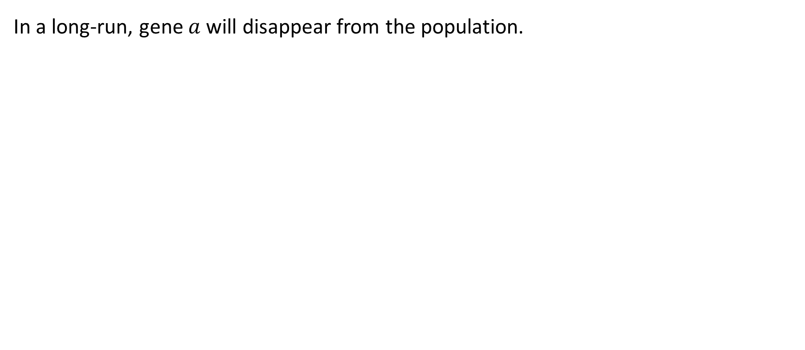
Application of Markov Chain (3) (Cont.)
In a long-run, gene $a$ will disappear from the population.
R CODE
23

Slide 24
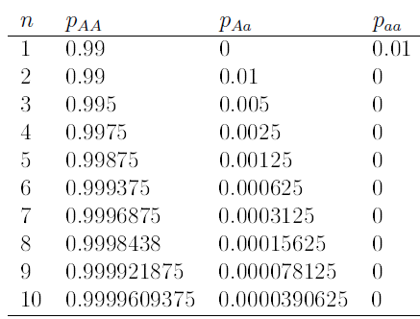
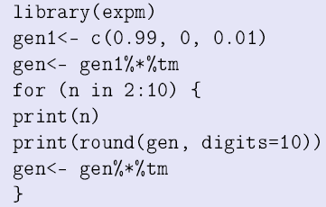
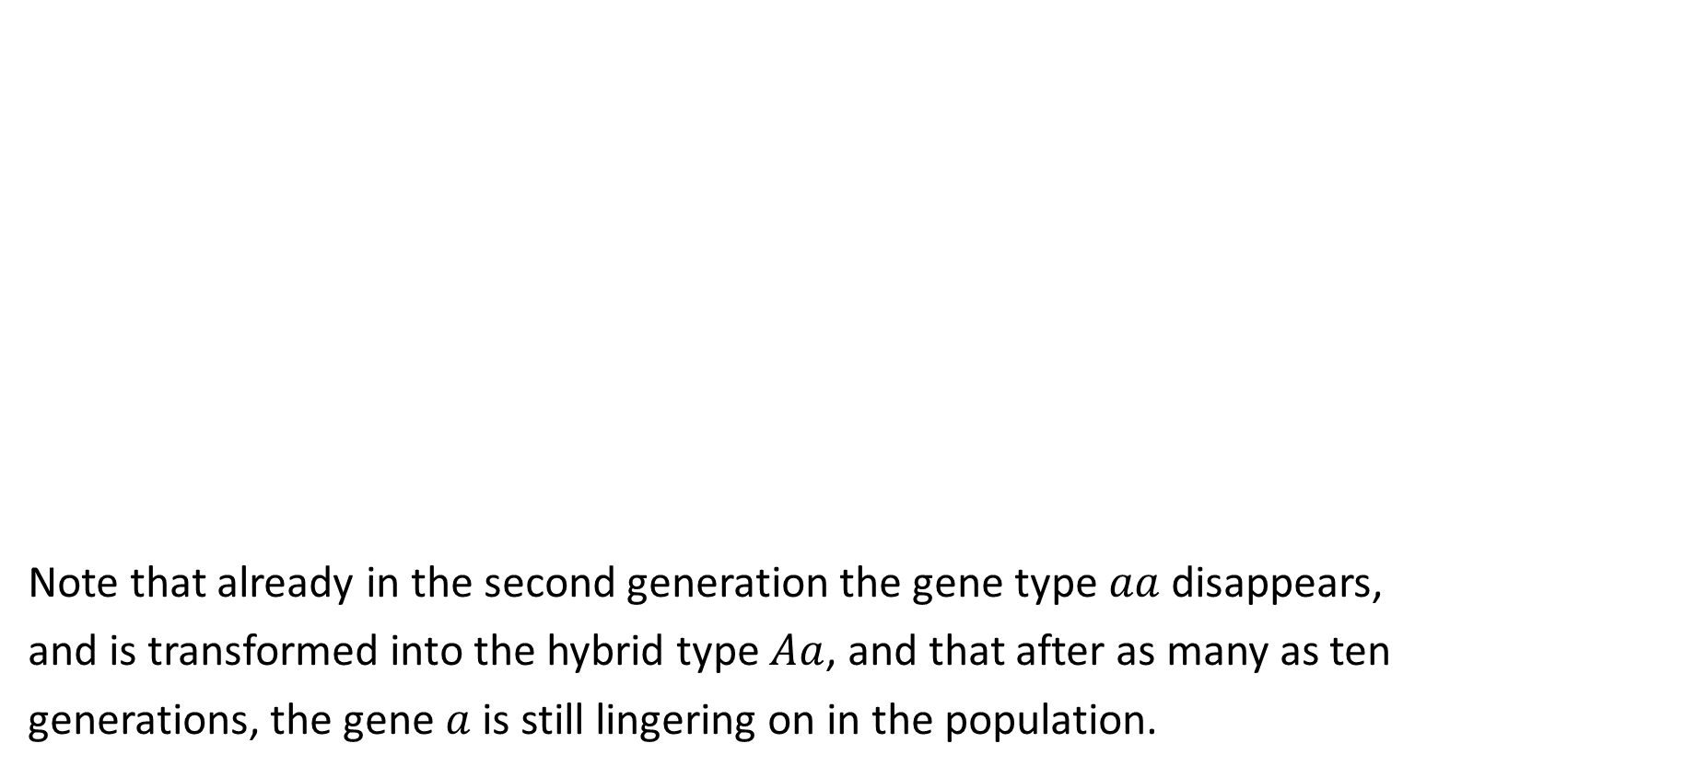
Application of Markov Chain (3) (Cont.)
Note that already in the second generation the gene type $aa$ disappears,
and is transformed into the hybrid type $Aa$, and that after as many as ten
generations, the gene $a$is still lingering on in the population.
24

Slide 25
Application of Markov Chain (4)
In this application, we present yet another chain that is not Markov. It has to do with weather conditions. On an intuitive level, weather tomorrow depends not just on today's weather but on the weather for several past days, if not the entire history of weather conditions in the region. To support this intuitive supposition numerically, we downloaded from kaggle.com an open-access historical hourly weather data for 2012-2017 (file “weather_description.csv”), focused only on the column for Los Angeles,
and clumped the weather conditions into the four categories:
S = {s="sky clear", c="cloudy", f="fog", r="rain"}.
25

Slide 26
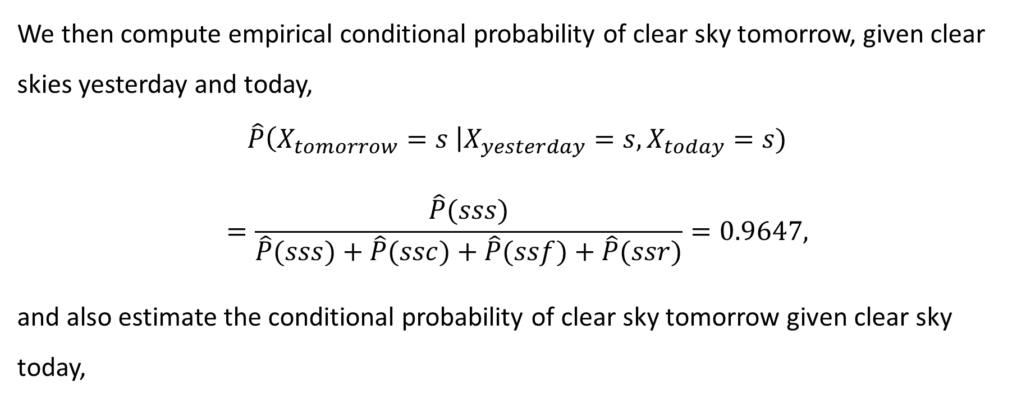
Application of Markov Chain (4) (Cont.)
We then compute empirical conditional probability of clear sky tomorrow, given clear skies yesterday and today,
$$\hat{P}\left(X_{tomorrow}=s \right|X_{yesterday}=s, X_{today}=s)$$
$$=\frac{\hat{P}(sss)}{\hat{P}(sss)+\hat{P}(ssc)+\hat{P}(ssf)+\hat{P}(ssr)}=0.9647,$$
and also estimate the conditional probability of clear sky tomorrow given clear sky today,
26

Slide 27
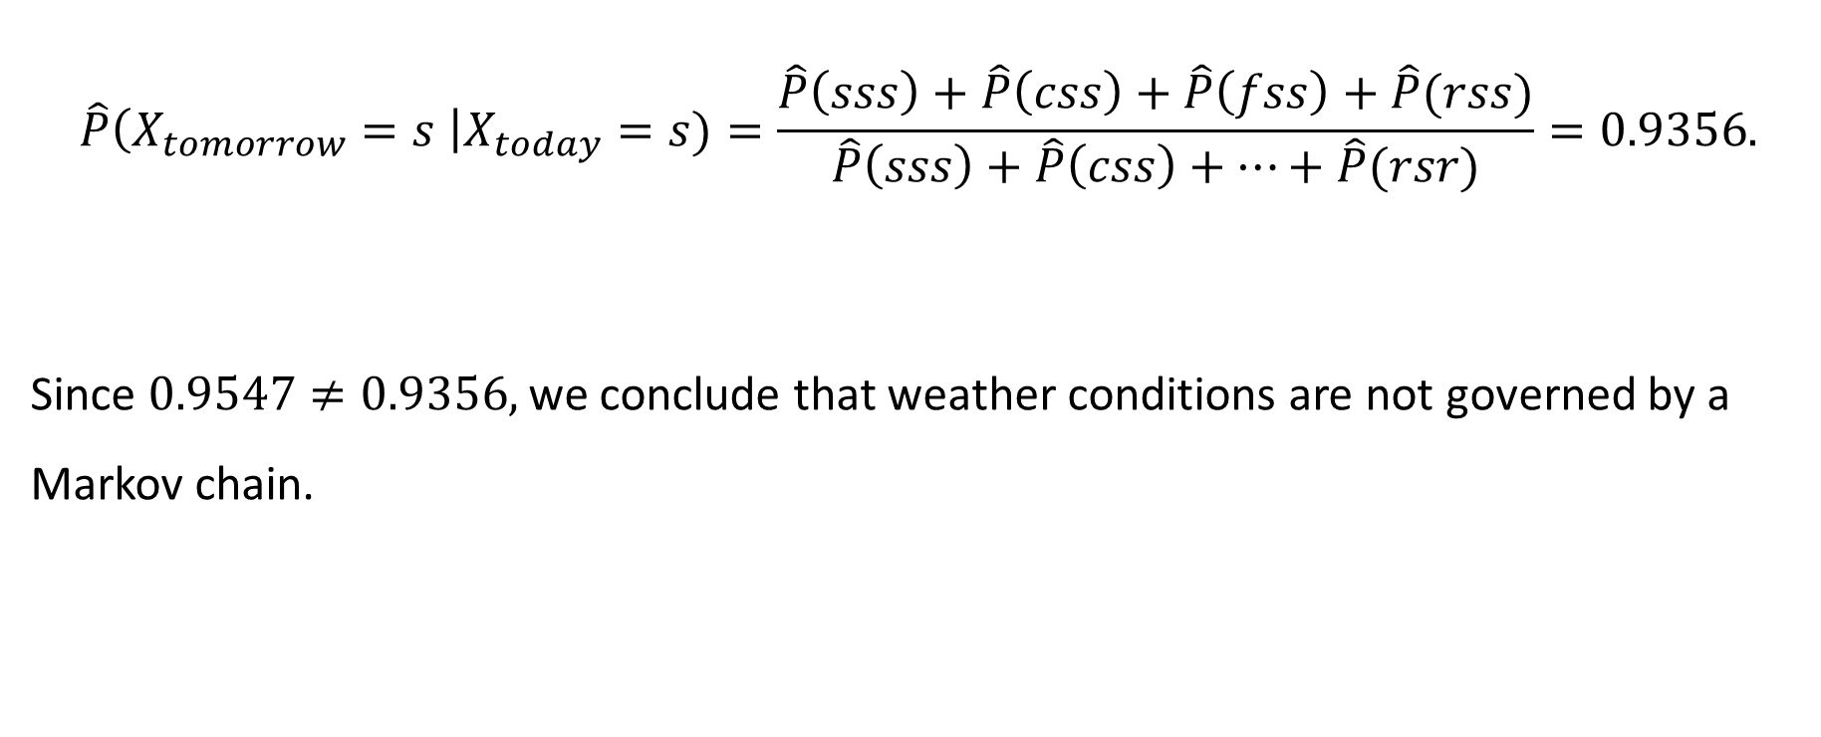
Application of Markov Chain (4) (Cont.)
$$\hat{P}\left(X_{tomorrow}=s \right|X_{today}=s)=\frac{\hat{P}\left(sss\right)+\hat{P}\left(css\right)+\hat{P}\left(fss\right)+\hat{P}(rss)}{\hat{P}\left(sss\right)+\hat{P}\left(css\right)+…+\hat{P}(rsr)}=0.9356.$$
Since $0.9547≠0.9356,$we conclude that weather conditions are not governed by a Markov chain.
R CODE
27

Slide 28
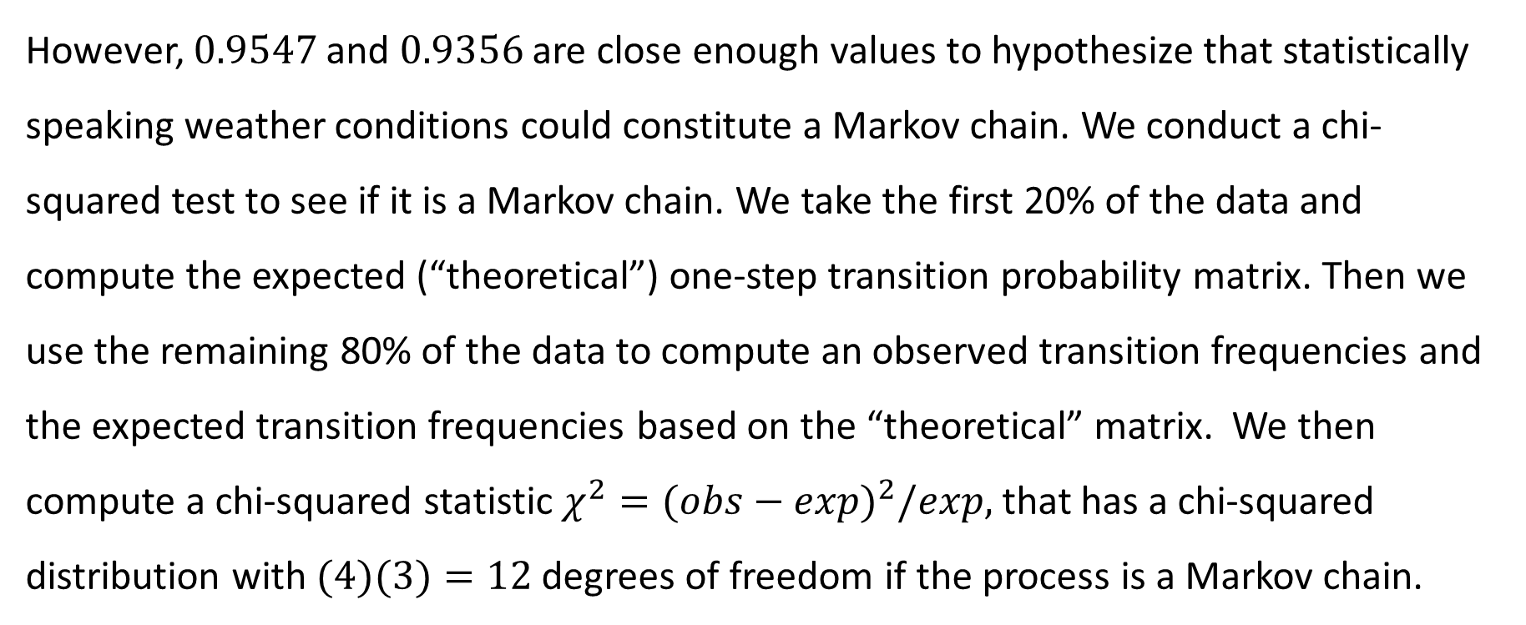
Application of Markov Chain (4) (Cont.)
However, $0.9547$and $0.9356$ are close enough values to hypothesize that statistically speaking weather conditions could constitute a Markov chain. We conduct a chi-squared test to see if it is a Markov chain. We take the first 20% of the data and compute the expected (“theoretical”) one-step transition probability matrix. Then we use the remaining 80% of the data to compute an observed transition frequencies and the expected transition frequencies based on the “theoretical” matrix. We then compute a chi-squared statistic $χ^{2}={(obs−exp)}^{2}/exp,⁡$that has a chi-squared distribution with $(4)(3)=12$degrees of freedom if the process is a Markov chain.
28

Slide 29
Application of Markov Chain (4) (Cont.)
Observed Transition Frequencies
[,1] [,2] [,3] [,4]
[1,] 18819 1143 712 196
[2,] 1056 4995 642 260
[3,] 755 582 4474 231
[4,] 241 233 214 1649
Expected Transition Frequencies
[,1] [,2] [ ,3] [,4]
[1,] 18633.9 1193.4 915.8 126.9
[2,] 1013.4 5104.0 570.5 265.1
[3,] 1013.5 740.6 4088.6 199.2
[4,] 205.8 580.6 367.5 1183.2
R CODE
chi-squared statistic = 703.055
p-value = 9.780797e-143 < 0.05
Conclusion: not a Markov chain
29

Slide 30
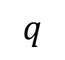
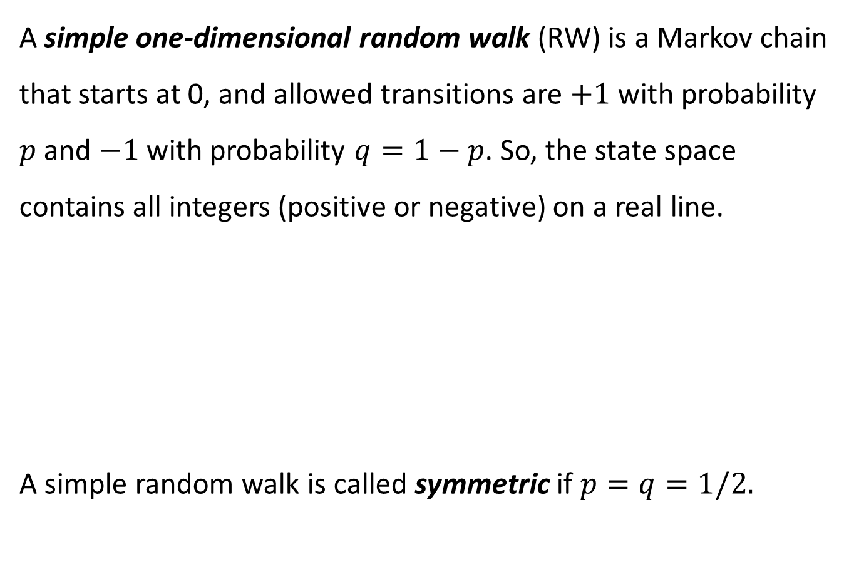
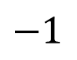
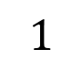
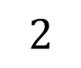
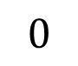
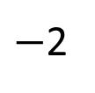
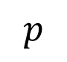
A simple one-dimensional random walk (RW) is a Markov chain that starts at 0, and allowed transitions are $+1$ with probability $p$ and $−1$ with probability $q=1−p$. So, the state space contains all integers (positive or negative) on a real line.
A simple random walk is called symmetric if $p=q=1/2.$
RANDOM WALK
$$q$$
$$p$$
$−$2
$$−1$$
$$0$$
$$1$$
$$2$$
30

Slide 31
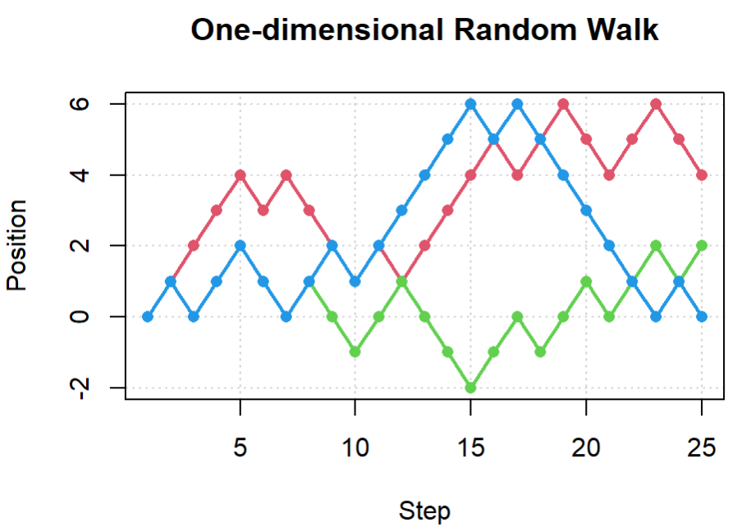
Simulated Trajectories of Random Walk
R CODE
31

Slide 32
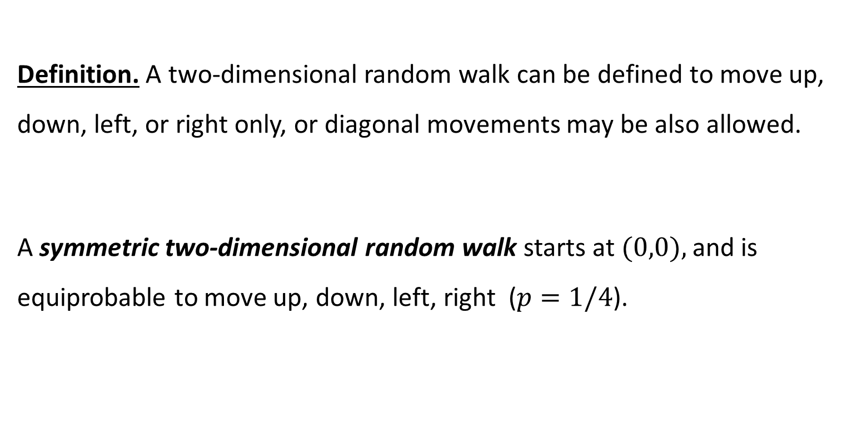
Two-dimensional Random Walk
Definition. A two-dimensional random walk can be defined to move up, down, left, or right only, or diagonal movements may be also allowed.
A symmetric two-dimensional random walk starts at $(0,0),$and is equiprobable to move up, down, left, right ($p=1/4$).
32

Slide 33
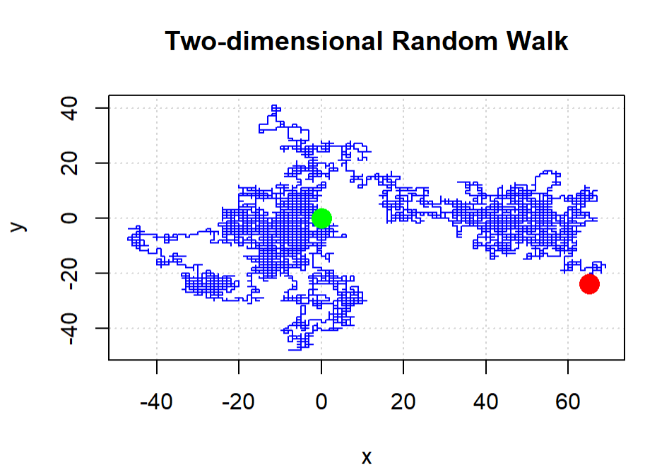
R CODE
33

Slide 34
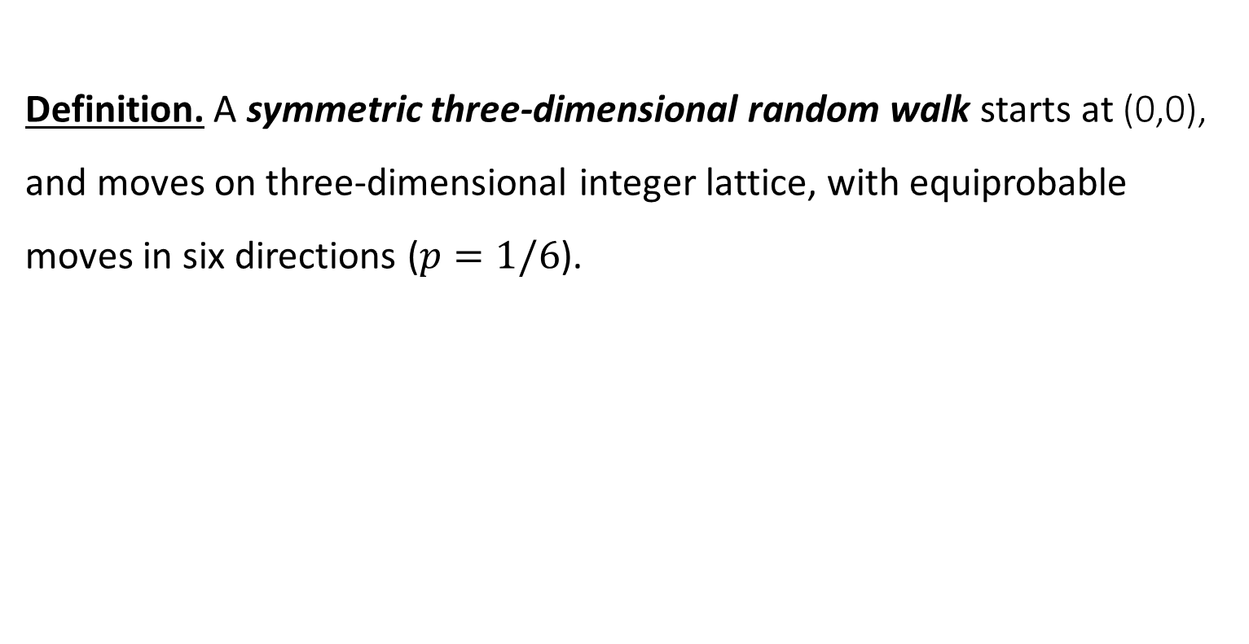
Three-dimensional Random Walk
Definition. A symmetric three-dimensional random walk starts at (0,0), and moves on three-dimensional integer lattice, with equiprobable moves in six directions ($p=1/6$).
34

Slide 35
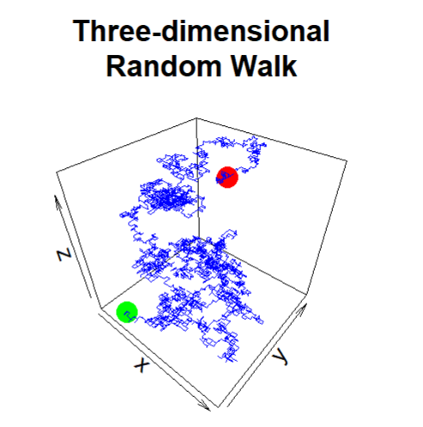
R CODE
35

Slide 36
Must-know Facts About Random Walk
A symmetric 1D or 2D RW will come back to the origin infinitely many times (is recurrent), whereas an asymmetric 1D or 2D RW will come back only a finite number of times and will eventually wander away (is transient). That is, a symmetric RW is recurrent, and an asymmetric RW is transient.
Any random walk (symmetric or not) in 3D or a higher dimension is transient.
For example, a bug crawling randomly along a railroad track will eventually return. A drunk man will find his way home, but a drunk bird will be lost forever.
36

Slide 37
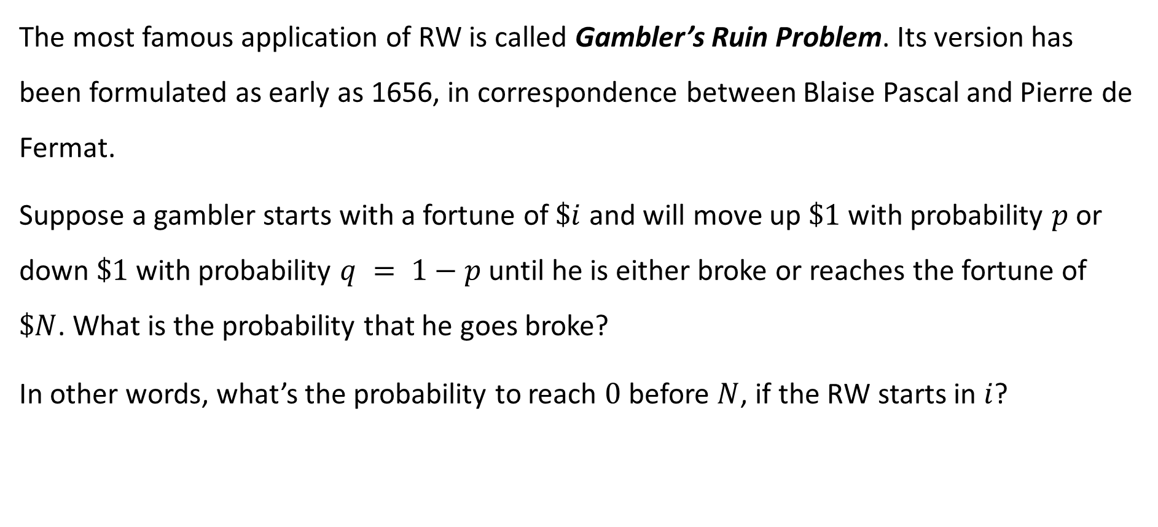
Application of Random Walk
The most famous application of RW is called Gambler’s Ruin Problem. Its version has been formulated as early as 1656, in correspondence between Blaise Pascal and Pierre de Fermat.
Suppose a gambler starts with a fortune of $\$i$ and will move up $\$1$ with probability $p$ or down $\$1$with probability $q = 1−p$until he is either broke or reaches the fortune of $\$N$. What is the probability that he goes broke?
In other words, what’s the probability to reach $0$ before $N$, if the RW starts in $i$?
37

Slide 38
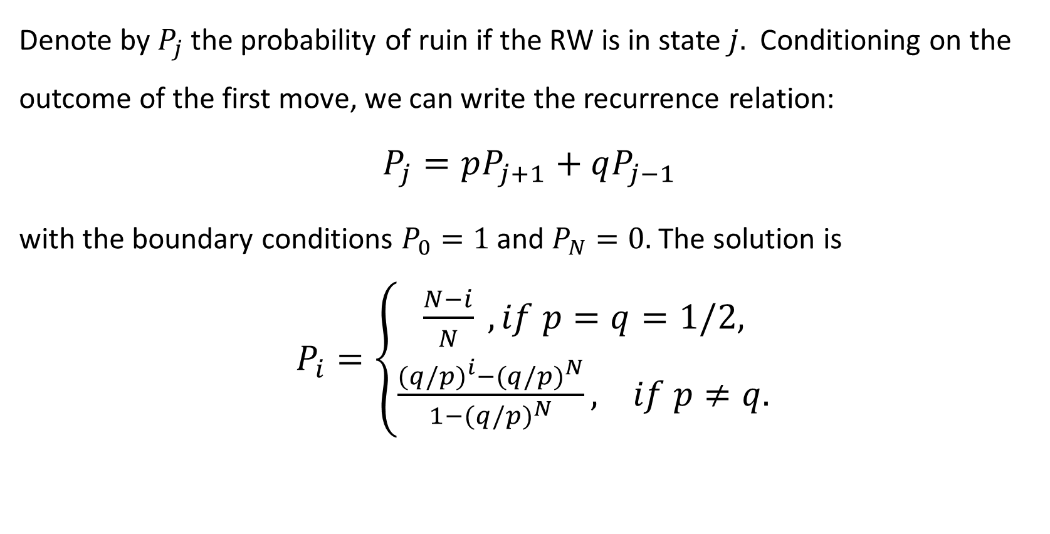
Gambler’s Ruin Problem (cont.)
Denote by $P_{j}$ the probability of ruin if the RW is in state $j.$ Conditioning on the outcome of the first move, we can write the recurrence relation:
$$P_{j}=pP_{j+1}+qP_{j−1}$$
with the boundary conditions $P_{0}=1$ and $P_{N}=0.$ The solution is
$P_{i}=\left\{\begin{aligned}\frac{N−i}{N} , if p=q=1/2, \\ \frac{{(q/p)}^{i}−{(q/p)}^{N}}{1−{(q/p)}^{N}}, if p≠q.\end{aligned}\right.$
38

Slide 39
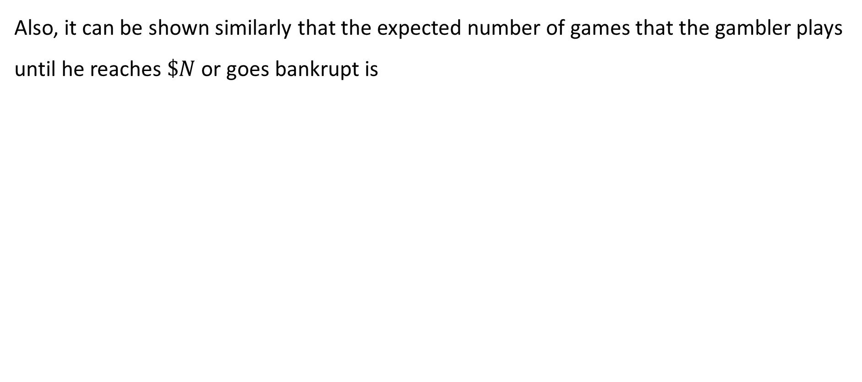
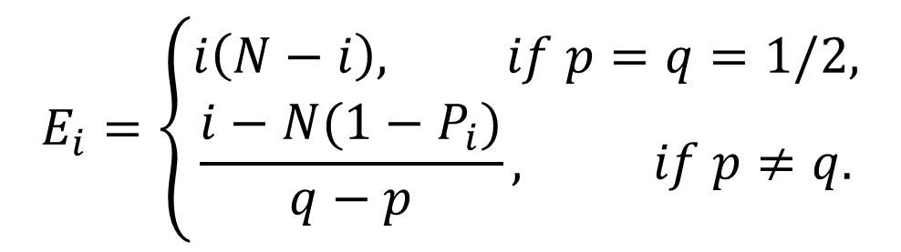
Gambler’s Ruin Problem (cont.)
Also, it can be shown similarly that the expected number of games that the gambler plays until he reaches $\$N$ or goes bankrupt is
$$E_{i}=\left\{\begin{aligned}i\left(N−i\right), if p=q=1/2, \\ \frac{i−N(1−P_{i})}{q−p}, if p≠q.\end{aligned}\right.$$
39

Slide 40
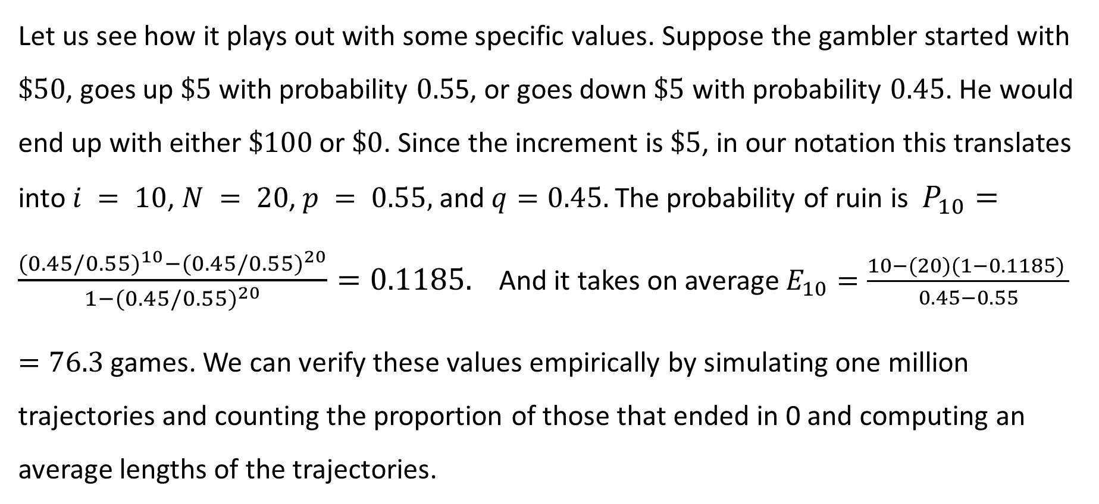
Gambler’s Ruin Problem (cont.)
Let us see how it plays out with some specific values. Suppose the gambler started with $\$50$, goes up $\$5$ with probability $0.5$5, or goes down $\$5$ with probability $0.45$. He would end up with either $\$100$or $\$0$. Since the increment is $\$5$, in our notation this translates into $i = 10$, $N = 20$, $p = 0.55,$ and $q=0.45.$ The probability of ruin is $P_{10}=\frac{{(0.45/0.55)}^{10}−{(0.45/0.55)}^{20}}{1−{(0.45/0.55)}^{20}}=0.1185.$ And it takes on average $E_{10}=\frac{10−(20)(1−0.1185) }{0.45−0.55}$
$=76.3$ games. We can verify these values empirically by simulating one million trajectories and counting the proportion of those that ended in 0 and computing an average lengths of the trajectories.
40

Slide 41
Gambler’s Ruin Problem (cont.)
Proportion of trajectories that end in 0
0.118353
Mean number of games
76.32965
R CODE
41

Slide 42

Gambler’s Ruin Problem Exercise
Suppose the gambler started with $\$50$, goes up $\$5$ with probability $0.52$, or goes down $\$5$ with probability $0.48$. Assume the game ends when the gambler reaches $120 or $0.
Compute theoretically the probability of ruin.
Compute theoretically the expected number of games.
Estimate empirically the probability of ruin.
Estimate empirically the expected number of games.
42

Slide 43

Gambler’s Ruin Problem Exercise Solution
In our notation, $i = 10$, $N = 24$, $p = 0.52,$ and $q=0.48$.
Compute theoretically the probability of ruin.
$P_{10}=\frac{{(0.48/0.52)}^{10}−{(0.48/0.52)}^{24}}{1−{(0.48/0.52)}^{24}}=0.354616.$
Compute theoretically the expected number of games.
${ E}_{10}=\frac{10−(24)(1−0.354616) }{0.48−0.52}$ $=137.2304$ games.
43

Slide 44
Gambler’s Ruin Problem Exercise
Estimate empirically the probability of ruin.
0.354777
Estimate empirically the expected number of games.
136.9053
R CODE
44

Slide 45

A stochastic process $\{N(t), t≥0\}$ is called a Poisson process if it counts the total number of events occurring by time $t$, $N(0)=0$, and $N(t)$ has a Poisson distribution with rate $λt,$ that is,
$P\left(N\left(t\right)=n\right)=\frac{{(λt)}^{n}}{n!} e^{−λt}, n=0, 1, 2, …,$
where $λt=E\left(N\left(t\right)\right)=Var\left(N\left(t\right)\right).$
POISSON PROCESS
45

Slide 46

Historical Note on Poisson Distribution and Process
Siméon Poisson (1781 – 1840) was a French
mathematician and physicist.
He is the one who introduced Poisson Distribution.
The reference to a Poisson process first appeared in
two independent publications in 1940.
46

Slide 47

POISSON PROCESS (CONT.)
Facts: A Poisson process as a special case of a Markov chain. The state space of a Poisson process is $S=\left\{0, 1, 2, 3, …\right\}.$The process jumps from initial state 0 to state 1, then to state 2, etc. The jumps are always of size 1, and transitions between states are allowed only in the direction of increase. Moreover, a Poisson process includes the time component. It matters how long the process halts between jumps. This type of Markov chain is called a continuous-time Markov chain.
47

Slide 48

POISSON PROCESS (CONT.)
Definition. An interarrival time is the time between two consecutive occurrences of
events.
Fact: Interarrival times are independent exponentially distributed random variables with the density function $f\left(t\right)=λ\exp\left(−λt\right), t≥0.$ Note that the mean is $1/λ.$
Example: Events occur according to a Poisson process with rate $λ=2$ per minute. Then, on average, one needs to wait for $1/λ =1/2$ of a minute for another occurrence.
Fact: In a Poisson process, two events cannot occur at the same time since the interarrival times are exponential and so the probability of exact equality to zero is zero.
48

Slide 49
EXAMPLES OF POISSON PROCESSES
A Poisson process is used to model occurrences of rare events. Here are some instances of Poisson processes: the number of people who enter a store or a bank or a restaurant or a gym or a National Park, the number of cars that pass a certain intersection, the number of auto accidents on a certain stretch of a freeway, the number of births in a hospital, the number of meteors in the night sky, or the number of phone calls to a credit card customer service. Typically, natural disasters occur according to a Poisson process: earthquakes, volcano eruptions, wildfires, etc. Of course, in all the above examples, the considered time period should be short enough for the rate of occurrence to be constant.
49

Slide 50
EXAMPLES OF NON-POISSON PROCESSES
Some examples of processes that clearly are not governed by a Poisson law are events that happen according to a schedule, for example, arrival of buses along a certain route, road closures due to construction work, quarry blasts, and building demolitions. Also, events that happen in a competing market, where two rival companies might be scheduling two events at the same time. For instance, two pharmaceutical companies might simultaneously bring to the market two cardiac medications, or two production companies might release two movies on the same day. In addition, some periodic (or seasonal) natural phenomena cannot be modeled as a Poisson process, i.e., eruptions of Old Faithful geyser in Yellowstone National Park, ocean tides, the appearance of sunspots, etc.
50

Slide 51

SIMULATION OF POISSON PROCESS
To simulate a trajectory of a Poisson process, we generate exponentially distributed interarrival times. And then plot piece-wise constant function, starting at zero and increasing jumps by one.
R CODE
51

Slide 52

APPLICATION OF POISSON PROCESS (1)
In seismology, occurrence of earthquakes is often modeled according to a Poisson process. We obtain the data from the Southern California
Earthquake Data Center's website
https://service.scedc.caltech.edu/eq-catalogs/
date_mag_loc.php. The data are on earthquakes in
Southern California with a minimum magnitude of 3.0
that occurred between 2012 and 2018. We remove those earthquakes that were registered within three hours of their predecessors (possibly aftershocks).
DATA SET
52

Slide 53

APPLICATION OF POISSON PROCESS (1) (CONT.)
To see if occurrence of earthquakes is a Poisson process or not, we compute the lengths of the interarrival times and check if they are exponentially distributed.
R CODE
53

Slide 54
APPLICATION OF POISSON PROCESS (1) (CONT.)
Observed Frequencies
1 2 3 4 5 6 7
342 178 117 49 39 24 42
Expected Frequencies
319.8 190.5 113.5 67.6 40.3 24.0 35.4
Chi-squared statistic
8.883823
P-value
0.1137888 > 0.05, so the interarrival times are exponentially distributed and we conclude that the process is Poisson.
54

Slide 55
POISSON PROCESS: EXERCISE (1)
The National Geophysical Data Center's website
https://www.ngdc.noaa.gov/hazel/view/hazards/volcano/event-search/
provides access to the Global Significant Volcanic Eruptions Database. Use the data set “volcanoesdata.csv” to verify that volcanic eruptions in the past 100 years can be modeled as a Poisson process.
DATA SET
55

Slide 56

POISSON PROCESS: EXERCISE (1) SOLUTION
R CODE
56

Slide 57

POISSON PROCESS: EXERCISE (1) SOLUTION (CONT.)
Observed Frequencies
1 2 3 4 5 6 7
96 66 95 43 29 13 34
Expected Frequencies
84.3 65.4 90.1 54.2 32.6 19.6 29.7
Chi-squared statistic
7.492589
P-value
0.1865064 > 0.05, the interarrival times are exponentially distributed and we conclude that the process is Poisson.
57

Slide 58

APPLICATION OF POISSON PROCESS (2)
In sports analytics, a Poisson process is used to model the process of goal scoring in a game. Consider a team game where players score only one point at a time, for instance, ice hockey. Suppose the points scored by team $A$ follow a Poisson process $\left\{N_{A}\left(t\right), t≥0\right\}$ with rate $λ_{A}$, and points scored by team$B$are governed by a Poisson process $\left\{N_{B}\left(t\right), t≥0\right\}$ with parameter $λ_{B}$. Assuming the two processes are independent, we can derive some interesting results.
58

Slide 59

APPLICATION OF POISSON PROCESS (2) (CONT.)
We can find the probability that one team scores ahead of the other team. Denote by $T_{A}$ and $T_{B}$ the respective interarrival times. We know that $T_{A}$ and $T_{B}$ are independent and exponentially distributed with parameters $λ_{A}$ and $λ_{B}$, respectively. We write $P\left(team A scores before team B\right)=P\left(T_{A}<T_{B}\right)=\int_{0}^{∞}{{e^{−λ_{B}t}λ_{A}e}^{−λ_{A}t}dt= \frac{λ_{A}}{λ_{A}+λ_{B}}.}$ Now switching $λ_{A}$ and $λ_{B},$ we get $P\left(team B scores before team A\right)=P\left(T_{B}<T_{A}\right)=\frac{λ_{B}}{λ_{A}+λ_{B}}$.
59

Slide 60

APPLICATION OF POISSON PROCESS (2) (CONT.)
To see how it works with numbers, suppose team $A$scores, on average, every
10 minutes, and team $B$scores every 12 minutes, on average. Then $λ_{A}=\frac{1}{10}=0.1$ goal per minute, and $λ_{B}=\frac{1}{12}=0.083$ goals per minute. Thus,
$$P\left(team A scores before team B\right)=\frac{λ_{A}}{λ_{A}+λ_{B}}=\frac{1/10}{\frac{1}{10}+\frac{1}{12}}=0.545,$$
and
$$P\left(team A scores before team B\right)=1−0.545=0.455.$$
60

Slide 61

APPLICATION OF POISSON PROCESS (2) (CONT.)
2. We can find the probability of a tie at the end of the game, and also the
probability that team $A$ (team $B$) wins. Let $T$ denote the length of the game. Let $\{N_{A}\left(t\right), t≥0\}$ and $\{N_{B}\left(t\right), t≥0\}$ be the Poisson processes of scoring for teams $A$ and $B$, respectively. Then, we can write
$P\left(game is tied\right)=P\left(N_{A}\left(T\right)=N_{B}\left(T\right)\right)=\sum_{n=0}^{∞}{P\left(N_{A}\left(T\right)=n, N_{B}\left(T\right)=n\right)}$
$$=\sum_{n=0}^{∞}{\frac{{(λ_{A}T)}^{n}}{n!}e^{−λ_{A}T}\frac{{(λ_{B}T)}^{n}}{n!}e^{−λ_{B}T}=e^{−(λ_{A}+λ_{B})T}\sum_{n=0}^{∞}{\frac{{(λ_{A}λ_{B}T^{2})}^{n}}{{(n!)}^{2}} , }}$$
61

Slide 62

APPLICATION OF POISSON PROCESS (2) (CONT.)
$$P\left(team A wins\right)=P\left(N_{A}\left(T\right)>N_{B}\left(T\right)\right)=\sum_{n=0}^{∞}{\sum_{k=1}^{∞}{P\left(N_{A}\left(T\right)=n+k, N_{B}\left(T\right)=n\right)}}=\sum_{n=0}^{∞}{\sum_{k=1}^{∞}{\frac{{(λ_{A}T)}^{n+k}}{(n+k)!}e^{−λ_{A}T}\frac{{(λ_{B}T)}^{n}}{n!}e^{−λ_{B}T}}}=e^{−(λ_{A}+λ_{B})T}\sum_{n=0}^{∞}{\left[\frac{{(λ_{A}λ_{B}T^{2})}^{n}}{n!}\sum_{k=1}^{∞}{\frac{{(λ_{A}T)}^{k}}{(n+k)!}}\right],}$$
and
$$P\left(team B wins\right)=P\left(N_{A}\left(T\right)<N_{B}\left(T\right)\right)=1−P\left(game is tied\right)−P\left(team A wins\right).$$
62

Slide 63

APPLICATION OF POISSON PROCESS (2) (CONT.)
In our example, ice hockey game lasts for $T=60$minutes. We compute
$P\left(game is tied\right)=$ $e^{−(λ_{A}+λ_{B})T}\sum_{n=0}^{∞}{\frac{{(λ_{A}λ_{B}T^{2})}^{n}}{{(n!)}^{2}} }$
$=e^{−(\frac{1}{10}+\frac{1}{12})(60)}\sum_{n=0}^{∞}{\frac{{((\frac{1}{10})(\frac{1}{12}) {(60)}^{2})}^{n}}{{(n!)}^{2}}=e^{−11}\sum_{n=0}^{∞}{\frac{{30}^{n}}{{(n!)}^{2}}=0.1166}}$,
$P\left(team A wins\right)=e^{−11}\sum_{n=0}^{∞}{\left[\frac{{30}^{n}}{n!}\sum_{k=1}^{∞}{\frac{6^{k}}{\left(n+k\right)!}}\right]=0.5590,}$ and
$P\left(team B wins\right)=1−0.1166−0.5590=0.3244.$
R CODE
61

Slide 64


Definition. A continuous-time Markov chain $\left\{X\left(t\right), t≥0\right\}$with state space $S=\{0, 1, 2, …\}$ is called a birth-and-death process if, given that the chain is in state $n$, the time to transition to state $n + 1$ (birth or arrival) is exponentially distributed with mean $1/λ_{n}$, and the time to transition to state $n − 1$ (death or departure) is exponentially distributed with mean 1/ $μ_{n}$. The two waiting times are independent. Simply put, births occur as a Poisson process, and deaths occur as a Poisson process and the two processes are independent.
BIRTH-AND-DEATH PROCESS
64

Slide 65

BIRTH-AND-DEATH PROCESS (CONT.)
Example. A Poisson process is an example of a birth-and-death process with $λ_{n}=λ$and $μ_{n}=0, n=0, 1, 2, ….$Because there are no deaths, it is a pure birth process. The probability that there are $n$ particles in the system at time $t$ is
$P_{n}\left(t\right)=\frac{{(λt)}^{n}}{n!} e^{−λt}, n=0,1,2,…, t≥0.$
65

Slide 66

BIRTH-AND-DEATH PROCESS (CONT.)
Example. A linear birth-and-death process is a birth-and-death process with parameters
$λ_{n}=λn$ and $μ_{n}=μn, n=0,1,2,…$ . Simply put, there are n particles in the system, and each of them independently of the others can give birth to one particle or die. The probability that there are $n$ particles in the system at time $t$ is
$P_{n}\left(t\right)=\left(1−P_{0}\right)\left(1−\frac{λ}{μ}P_{0}\right){\left(\frac{λ}{μ}P_{0}\right)}^{n−1}n=1,2,…,$where $P_{0}=\frac{μe^{\left(λ−μ\right)t}−μ}{λe^{\left(λ−μ\right)t}−μ}$ .
66

Slide 67


SIMULATION OF LINEAR BIRTH-AND-DEATH PROCESS
We simulate a trajectory of the linear birth-and-death process with parameters $λ=0.3$ and $μ=0.1.$
R CODE
67

Slide 68

APPLICATION OF BIRTH-AND-DEATH PROCESS (1)
Definition. An M/M/1 queue is a birth-and-death process with $λ_{n}=λ$ and $μ_{n}=μ, n=0,1, 2, 3, ….$ We assume $λ<μ$, meaning that deaths occur more frequently than births, or, otherwise, there is an accumulation of particles in the system. In this process, customers join a queue (representing births) at independent exponential times with parameter $λ,$ and leave the system (representing deaths) after going through the service, which time is exponentially distributed with parameter $μ.$ All
customers act independently. In the name of the process, M/M/1, “M”s stand for Markovian arrival and departure processes and “1” means a single server.
68

Slide 69
APPLICATION OF BIRTH-AND-DEATH PROCESS (1) (CONT.)
Examples. An example of M/M/1 queue is the number of customers in a bank with
a single bank teller: customers enter the bank and join the line to the bank teller, then when it is their turn, they get a service from the teller and leave the bank. Another example is the number of broken cars in a repair shop with a single repairman: broken cars are added to the line to get a service from the repairman, and leave the shop once they are repaired.
69

Slide 70

APPLICATION OF BIRTH-AND-DEATH PROCESS (1) (CONT.)
Queueing theory is a well-developed area of stochastic processes. Of interest are:
The limiting (or steady-state) probabilities that there will be $n$ customers in the system $P_{n}=\lim_{t→∞}{P_{n}\left(t\right)=\left(1−\frac{λ}{μ}\right){\left(\frac{λ}{μ}\right)}^{n}, n=0,1,2,….}$
The average number of customers in the system in a long run is $\frac{λ}{μ−λ}$ .
70

Slide 71

APPLICATION OF BIRTH-AND-DEATH PROCESS (1) (CONT.)
To see how it works with numbers, consider M/M/1 system in which arrivals occur with the rate $λ=1$ per minute, and departures occurs with the rate $μ=1.5$ per minute. The steady-state probabilities are $P_{n}$ $=\left(1−\frac{λ}{μ}\right){\left(\frac{λ}{μ}\right)}^{n}=\left(1−\frac{1}{1.5}\right){\left(\frac{1}{1.5}\right)}^{n}=\left(\frac{1}{3}\right){\left(\frac{2}{3}\right)}^{n}, n=0,1,2,….$
In the long run, there will be, on average, $\frac{λ}{μ−λ}=\frac{1}{1.5−1}=2$ customers in the system at any given time.
71

Slide 72


APPLICATION OF BIRTH-AND-DEATH PROCESS (1) (CONT.)
We plot a trajectory with $λ=1,$
$μ=1.5,$ and 500 jumps.
We simulate 50,000 jumps
and compute the mean
number of customers
1.823064
R CODE
72

Slide 73

M/M/1 QUEUE: EXERCISE
Simulate a trajectory of an M/M/1 queue with 500 jumps for:
$λ=0.5$ and $μ=1$,
$λ=1$ and $μ=1$,
and
$λ=1.5$ and $μ=1.$
73

Slide 74

M/M/1 QUEUE: EXERCISE SOLUTION
R CODE
74

Slide 75

M/M/1 QUEUE: EXERCISE SOLUTION (CONT.)
75

Slide 76

M/M/1 QUEUE: EXERCISE SOLUTION (CONT.)
76

Slide 77

APPLICATION OF BIRTH-AND-DEATH PROCESS (2)
Bird flock size is often modeled as a birth-and-death process with immigration and emigration. In this model, $λ_{n}=λn+α$ and $μ_{n}=μn+β$ where $α$ is the rate of immigration (joining the flock) and $β$ is the rate of emigration (leaving the flock). Note that because of immigration, the flock would never die out. We generate a trajectory of the process until the flock size increases from 10 to 25 birds, assuming $λ=1.4, μ=1.2, α=0.3,$ and $β=0.1.$
77

Slide 78

APPLICATION OF BIRTH-AND-DEATH PROCESS (2) (CONT.)
R CODE
78

Slide 79

BIRD FLOCK SIZE EXERCISE
Plot a trajectory of a birth-and-death process with immigration and emigration with $λ=0.8, μ=1.1, α=0.1,$ and $β=0.2.$ Assume it starts with 20 birds and ends with 30 birds.
79

Slide 80

BIRD FLOCK SIZE EXERCISE SOLUTION
R CODE
80

Slide 81

Definition. A branching process is a discrete-time stochastic process that keeps track of the size of the $n$th generation of multiplying particles. It starts with some number of particles in the $0$th generation. Each particle survives for one-time unit, at the end of which it splits into a random number of particles with a known probability distribution. The offspring particles survive for one-time unit, and produce a random number of offspring, independently from each other, and the process continues.
BRANCHING PROCESS
81

Slide 82

SIMULATION OF BRANCHING PROCESS
R CODE
82

Slide 83

Historical Note
Branching process is also called Galton process after Sir Francis Galton (1822-1911), an Englishman, who made a significant contribution to many scientific fields. He was interested in survival of surnames of noble English families when he came up with a branching process.
83

Slide 84
DR. OLGA’S GENEALOGY TREE
DAUGHTER
SON
84

Slide 85

BRANCHING PROCESS (CONT.)
Fact: Branching process is a Markov chain.
Definition. Denote by $Z$ the random number of offspring of one particle. Let $μ$ denote the expected number of $Z.$ If $μ<1,$ the process is called subcritical; if $μ=1,$ the process is called critical, and if $μ>1$, the process is termed supercritical.
Fact: If $μ≤1,$ the process will eventually die out with probability 1.
If $μ>1$, the process can still die out with a positive probability $π_{0}$ but
85

Slide 86

BRANCHING PROCESS (CONT.)
$π_{0}<1$ and is the smallest positive solution of the equation:
$π_{0}=\sum_{k=0}^{∞}{π_{0}^{k}P\left(Z=k\right).}$
Example. Suppose a particle produces no particles 20% of the time, one particle 50% of the time, and two particles 30% of the time. Then $P\left(Z=0\right)=0.2, P\left(Z=1\right)=0.5,$ and $P\left(Z=2\right)=0.3.$ Its mean is $μ=EZ=\left(0\right)\left(0.2\right)+\left(1\right)\left(0.5\right)+\left(2\right)\left(0.3\right)=1.1>1,$ the process is supercritical, and the probability of extinction $π_{0}$ solves $π_{0}=0.2π_{0}^{0}+0.5π_{0}^{1}+0.3π_{0}^{2},$ or $0.3$ $π_{0}^{2}−0.5$ $π_{0}+0.2=0.3\left(π_{0}−1\right)\left(π_{0}−\frac{2}{3}\right)=0.$ So, $π_{0}=2/3.$
We simulate 1,000 trajectories and compute empirical probability of 0.662.
R CODE
86

Slide 87

APPLICATION OF BRANCHING PROCESS
Based on work by Alfred J. Lotka in 1931 who analyzed the data from the 1920 U.S. Census, suppose that male offspring has the distribution: $p\left(0\right)= 0.4828$ and $p(n) = (0.228292{)(0.5586)}^{n−1}, n = 1, 2, 3,… .$ The expected size of male offspring is
$μ=(0.228292{)\sum_{n=1}^{∞}{n}(0.5586)}^{n−1}=\frac{0.228292}{{\left(1−0.5586\right)}^{2}}=1.171726>1,$ so the population growth is a supercritical process. The probability $π_{0}$ of extinction is the smallest positive solution to the equation $π_{0}=0.4828+\sum_{n=1}^{∞}{π_{0}^{n} (0.228292{)(0.5586)}^{n−1}=}0.4828+\frac{0.228292π_{0}}{1−0.5586π_{0}}$, which is a quadratic equation $0.5586π_{0}^{2}−1.0414π_{0}+0.4828=0.$ The solution is $π_{0}$ $= 0.864304$.
87

Slide 88
MORE EXAMPLES OF BRANCHING PROCESSES
Here are more examples of processes that are modeled well by a branching process:
Growth of a colony of bacteria
Spread of an infectious diseases
Spread of a computer virus
Parlaying strategy in gambling
88

Slide 89
BRANCHING PROCESS EXERCISE
Parlaying in gambling is defined as a series of bets in which winnings are used as a stake for further bets. Suppose a gambler starts with a stake of $1, and can win $1 with probability 0.3, or $5 with probability 0.2, or $10 with probability 0.1, or $0 with probability 0.4.
Show that this is a supercritical process.
Find the probability that the gambler's stake eventually turns into $0.
Simulate 1,000 trajectories and estimate the probability of ruin.
89

Slide 90

BRANCHING PROCESS EXERCISE SOLUTION
Show that this is a supercritical process.
$$μ=\left(1\right)\left(0.3\right)+\left(5\right)\left(0.2\right)+\left(10\right)\left(0.1\right)+\left(0\right)\left(0.4\right)=2.3>1.$$
Find the probability that the gambler's stake eventually turns into $0.
Let $π_{0}$ be the probability that the gambler’s stake eventually turns into $0. It is the smallest positive solution to the equation $π_{0}=0.4+0.3π_{0}+0.2π_{0}^{5}+0.1π_{0}^{10}$. Solved numerically, $π_{0}=0.5931886.$
Simulate 1,000 trajectories and estimate the probability of ruin.
0.6
R CODE
90

Slide 91


Definition. A standard one-dimensional Brownian motion $\left\{B\left(t\right), t≥0\right\}$ is a stochastic process that starts at zero, that is, $B\left(0\right)=0,$ and $B\left(t\right)\sim N\left(0,t\right), t>0.$
BROWNIAN MOTION
R CODE
91

Slide 92


HISTORICAL NOTE
In 1828, an English botanist Robert Brown (1773-1858) observed an erratic movement of dust particles in liquid (on a microscopic level) and described the motion in a publication.
In 1921, an American mathematician Norbert Wiener (1894 –1964) proposed a rigorous mathematical model explaining this motion. The erratic motion is explained by the particle being hit by the molecules of the liquid.
Brownian motion is often called a Wiener process.
92

Slide 93

BROWNIAN MOTION (CONT.)
Definition. A two-dimensional Brownian motion is a stochastic process that keeps track of two coordinates, both of which are independent Brownian motions.
R CODE
93

Slide 94

BROWNIAN MOTION (CONT.)
Definition. A three-dimensional Brownian motion is a stochastic
process that models position by
three coordinates, defined by
three independent Brownian motions.
R CODE
94

Slide 95


BROWNIAN MOTION (CONT.)
Definition. Suppose that $\left\{B\left(t\right), t≥0\right\}$
is a standard Brownian motion.
The process
$$X\left(t\right)= B\left(t\right)− tB\left(1\right), 0≤t≤1,$$
is called a Brownian bridge.
Note that $X(t)$ behaves like a Brownian Motion, but is limited to [0,1] and is tied at both ends since
$X\left(0\right)=X\left(1\right)=0$ (resembling a bridge).
R CODE
95

Slide 96


BROWNIAN MOTION (CONT.)
Definition. Let $\left\{B\left(t\right), t≥0\right\}$ denote a standard Brownian motion. A stochastic process $\left\{X\left(t\right)=μt+σB\left(t\right), t≥0\right\}$ is called a Brownian motion with the drift coefficient $μ$ and volatility coefficient $σ.$ Note
that $X\left(t\right)\sim N(μt, σ^{2}t)$.
R CODE
96

Slide 97

BROWNIAN MOTION (CONT.)
Definition. The stochastic process $\left\{X\left(t\right)=X\left(0\right)e^{−θt}+μ\left(1−e^{−θt}\right)+\frac{σ}{\sqrt{2θ}}e^{−θt}B\left(e^{2θt}−1\right), t≥0\right\}$ is called an Ornstein-Uhlenbeck process.
Facts: The mean tends to $μ$ as $t$ increases, so the drift $μ$ is the long-term mean, and the process is called mean-reverting. The parameter $θ$ represents the rate by which the process reverts towards the mean. In addition, the variance of this process is bounded by a constant $\frac{σ^{2}}{2θ}$ and in the long run, approaches this constant.
97

Slide 98

BROWNIAN MOTION (CONT.)
R CODE
98

Slide 99

APPLICATION OF BROWNIAN MOTION (1)
Brownian bridge is used to model movements of herds as they walk on their trails
during daylight time and return to their designated lodging for an overnight stay (maybe for source of water). The main goal of the research is to estimate the distance between the north-most and south-most points that the deer have reached. This distance
approximates the diameter of the deer home range. Assuming that the unit of
measurement is one-tenth of a mile, we simulate 1,000 trajectories to give an empirical estimate of the diameter of home range that deer cover within 8-hour day light time (480 minutes). The answer is (26.80793$)\left(0.1\right)=2.68$ miles.
R CODE
99

Slide 100

APPLICATION OF BROWNIAN MOTION (2)
A Brownian motion with drift and volatility is used to model the behavior of a stock price over time. The data set downloaded from
https://nance.yahoo.com/quote/AMZN/history/
contains Amazon.com, Inc. daily stock prices at the closing time of stock market exchange between 12/27/2021 and 12/23/2022. We estimate drift and volatility by noticing that $∆X=X\left(t+1\right)−X\left(t\right)=μ+σB\left(1\right)\sim N(μ, σ^{2}$), so the estimate of $μ$ is the average of $∆X$ and the estimate of $σ$ is the standard deviation of $∆X.$
100

Slide 101

APPLICATION OF BROWNIAN MOTION (2) (CONT.)
R CODE
101

Slide 102
APPLICATION OF BROWNIAN MOTION (3)
As opposed to stock that can rise indefinitely, commodity prices move in a limited range in a free market. If the price is high, the demand drops, and consequently, the price drops. Likewise, if the price is low, demand increases, and eventually, the price increases. This characteristic is called a reversion to a long-run mean and, as we know, an Ornstein-Uhlenbeck (OU) process is a good mathematical model that captures this mean-reversion property. We use it to model natural gas prices between 1/4/2010 and 8/11/2020 (downloaded from kaggle.com).
102

Slide 103

APPLICATION OF BROWNIAN MOTION (3) (CONT.)
Ornstein-Uhlenbeck process $\{X\left(t\right), t≥0\}$ satisfies the equation
$$∆X=X\left(t+1\right)−X\left(t\right)=θμ−θX\left(t\right)+σB\left(1\right).$$
It means that we can regress $∆X$ on $X(t)$ and, denoting the fitted intercept and slope by $a$ and $b$, respectively, we see that the estimate of $θ$ is $−b$, estimate of $μ$ is $−a/b,$ and $σ$ is estimated as the sample standard deviation of the regression error.
103

Slide 104

APPLICATION OF BROWNIAN MOTION (3) (CONT.)
R CODE
104

Slide 105





BROWNIAN MOTION EXERCISE
Name the depicted processes.
Ornstein-Uhlenbeck
2D Brownian motion
3D Brownian motion
BM w/drift and volatility
Brownian bridge
105

Slide 106
BROWNIAN MOTION EXERCISE (CONT.)
Match each description with the process name.
movement of a second grader after school
price of gold, sugar, cotton, soybean
price of the stock of Johnson & Johnson,
Starbucks, Disney, Boeing, and Tesla
movement of a restless second-grader along
a hallway during recess (between two recess bells)
exchange rate of Japanese yens and Canadian dollars
2D Brownian motion
Ornstein-Uhlenbeck process
Brownian motion with drift and volatility
Brownian bridge
Ornstein-Uhlenbeck process
106

Slide 107
BROWNIAN MOTION EXERCISE (CONT.)
movement of bacterium on the water surface
movement of aerosol particles in the air
daily movements of a pelican within its home range
on Grande Isle, Louisiana, as measured north-south
movement of molecules in boiling water
2D Brownian motion
3D Brownian motion
Brownian bridge
3D Brownian motion
107

Slide 108


